Slide 1
AWS Application Deployment
Application Deployment using AWS Amplify
Razin Bin Zaidun

Slide 2
Agenda
Introduction to AWS Amplify
How Amplify Works
Why Use Amplify
Cost Optimization
Summary & Recommendation

Slide 3
Introduction

Slide 4
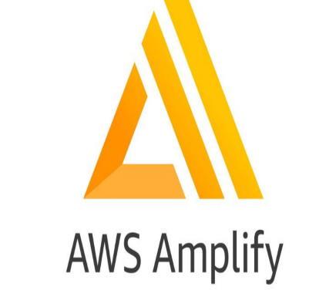
What is AWS Amplify?
Unified Development Platform​
AWS Amplify offers an integrated workflow for full-stack development including hosting, authentication, and data management.​
Support for Popular Frameworks​
Amplify supports major frontend frameworks like React, Vue, and Angular, plus mobile platforms for versatile app development.​
Simplified Backend Management​
It streamlines backend configuration and deployment, allowing developers to focus on building app features effectively.​
User-Friendly and Accessible​
Amplify features an intuitive interface and detailed documentation accessible to developers of all skill levels.​

Slide 5
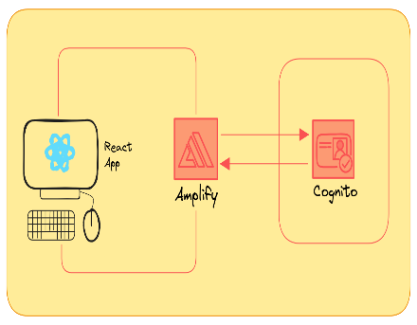
How Amplify Works
Git-Based CI/CD Workflow​
Amplify deploys updates automatically on code commit, ensuring continuous integration and delivery without manual steps.​
Unified Development Framework​
Developers define backend resources using TypeScript in structured files, streamlining backend configuration.​
Cloud Sandbox Environment​
Isolated cloud sandboxes allow developers to independently test and iterate applications rapidly.​
Backend Configuration Integration​
Amplify outputs a JSON file encapsulating backend setups for seamless frontend-backend integration.​

Slide 6
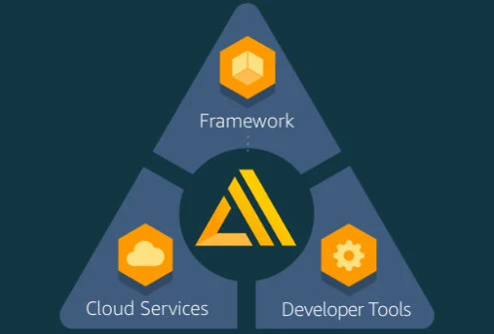
Why Use Amplify
Beginner-Friendly Setup​
Amplify offers easy setup with simple CLI and prebuilt UI components to streamline development.​
Rapid Prototyping​
Sandbox environments enable fast iteration and testing, perfect for agile workflows.​
Integrated Backend Services​
Declarative backend definitions let developers configure authentication, data models, and storage easily.​
Global Deployment​
Automatic deployment to global CDN ensures scalable and maintainable applications with minimal overhead.​

Slide 7

Cost Optimization
Cost Efficiency and Accessibility​
AWS Amplify is cost-efficient and accessible to developers with various budgets, supporting the AWS Free Tier.​
Pay-As-You-Go Pricing​
Amplify users pay only for what they consume, eliminating upfront costs and fostering flexible budget management.​
Simplified Infrastructure Management​
Amplify abstracts complex infrastructure setup, reducing operational overhead and minimizing unexpected expenses.​

Slide 8
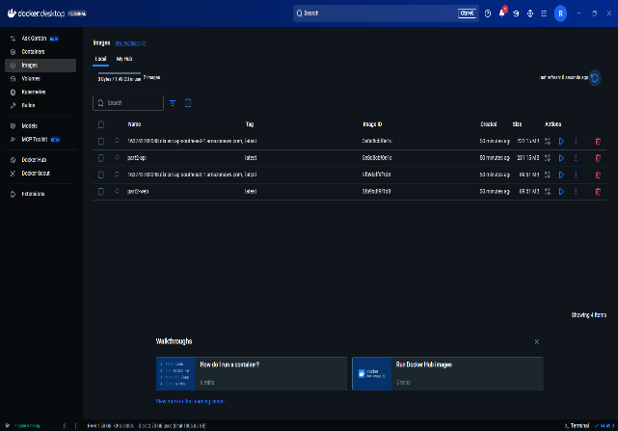
Amazon ECS Deployment with Docker
Containerized an existing project into Docker images for deployment into AWS Elastic Container Registry for image usage in AWS services.

Slide 9
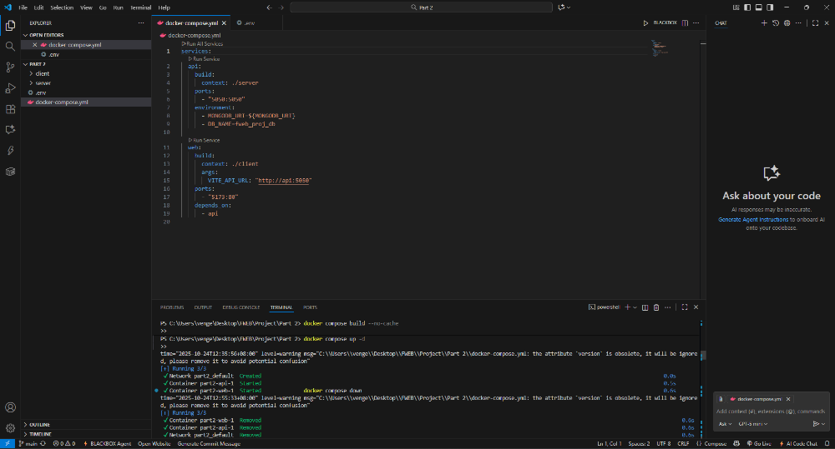

Slide 10
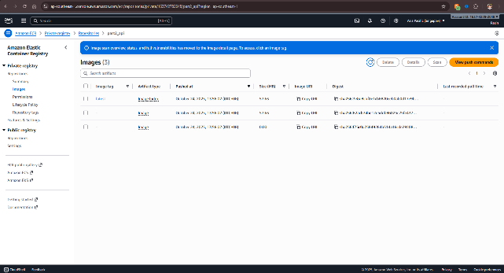
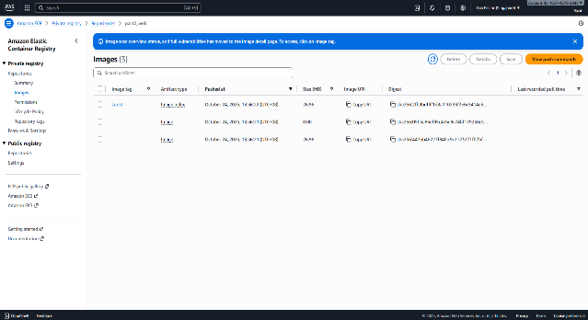
Amazon ECS Deployment with Docker
Docker images are now containerized in AWS ECR for use across AWS services.

Slide 11
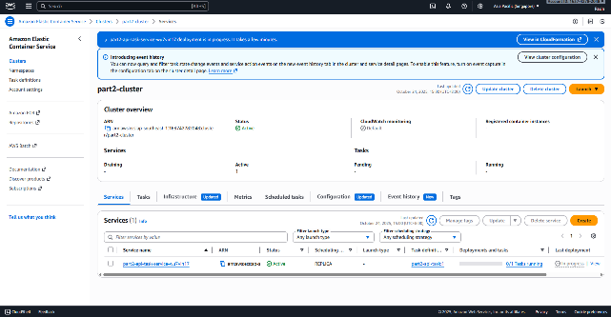
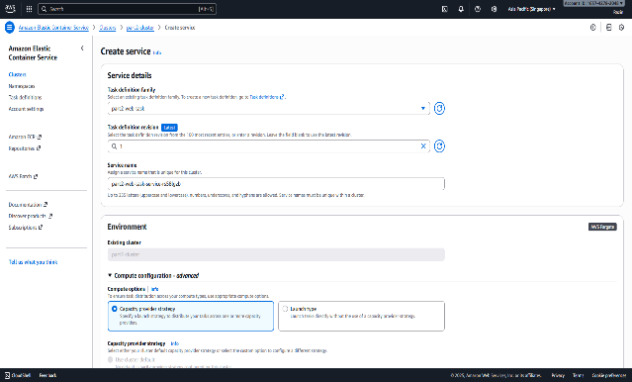
Amazon ECS Deployment with Docker
AWS Elastic Container Services created with both API (backend) & WEB (frontend) services running. This is what launces the container for the deployment of the application.

Slide 12
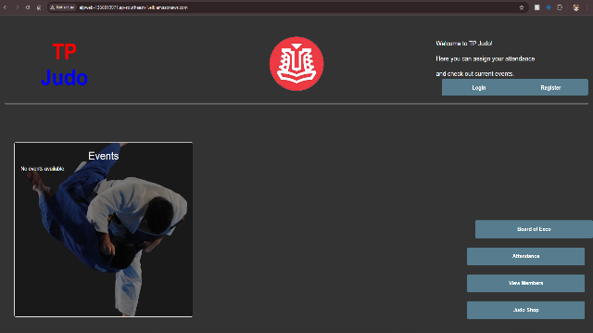
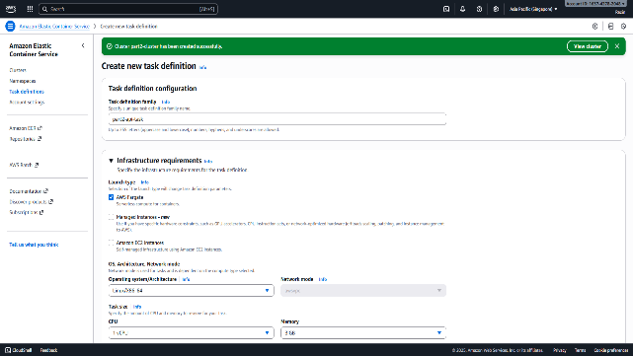
Amazon ECS Deployment with Docker
After configuring the AWS ECS task definitions, the application is finally deployed.

Slide 13

Targeted Users
Beginners in Cloud Development​
Amplify offers intuitive setup and tutorials, lowering the entry barrier for beginners in cloud development.​
Frontend Developers​
Frontend developers can integrate backend features like authentication and data storage easily without backend expertise.​
Startups and Small Teams​
Startups benefit from rapid deployment and minimal infrastructure, focusing on fast product development.​
Educators and Students​
Amplify supports academic use with free tiers and sandbox environments for building full-stack apps hands-on.​

Slide 14
Summary and Recommendations

Slide 15
Summary
Robust Development Platform​
Amplify provides a scalable and unified platform for full-stack application development with speed and simplicity.​
CI/CD and Frontend Support​
Automatic CI/CD integration and support for popular frontend technologies streamline development workflows.​
Ideal for Startups and Interns​
Amplify suits interns and startups for quick app building with minimal infrastructure management and cost control.​
Rapid Testing and Cost Optimization​
Sandbox environments enable fast testing, and cost optimization features ensure budget-friendly operations.​

